Slide 1
Events in node

Slide 2
1. What is Event?
Event can be consider as an action.
Events are used to execute corresponding functions or callbacks.
The event can be emitted or listen to an event with the help of EventEmitter class in node js.

Slide 3
2. Event types

Slide 4
3. Event Emitter Api
EventEmitter is a class provided default by Node js.
The EventEmitter is a module that facilitates communication/interaction between objects in Node.
EventEmitter is at the core of Node asynchronous event-driven architecture.
EventEmitter is used to create and handle custom events module.

Slide 5
4. Event Emitter Api
Methos of EventEmitter class:
Ref: https://www.tutorialspoint.com/nodejs/nodejs_event_emitter.htm

Slide 6
5. Multiple Event Listeners
What is an Event listener: An event listener is a procedure that waits for an event to occur and perform code to be executed.
E.g: eventEmitter.on('connection', listner);
Multiple Event Listeners is a process to add multiple event listeners for different events on the same element.

Slide 7
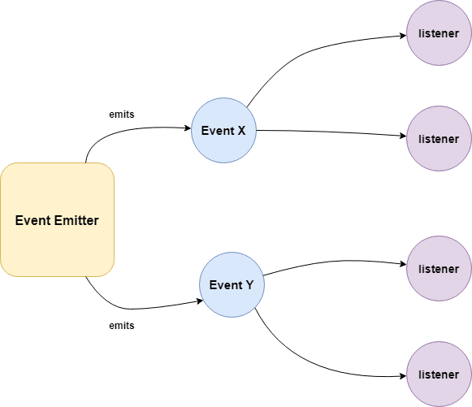
6. Event Emitter pattern

Slide 8
7. Class methods
addListener(event, listener): Adds a listener for the specified event.
on(event, listener): //works as same as addListener.
once(event, listener): Adds a one time listener to the event. This listener is invoked only the next time the event is fired, after which it is removed.
removeListener(event, listener): Removes a listener from the listener array for the specified event. // off()
removeAllListeners([event]): Removes all listeners, or those of the specified event. (Not good practice to use)
setMaxListeners(n): By default it allows 10 listeners, If needed more, we can use this method.
listeners(event): Returns an array of listeners for the specified event.
emit(event, args): Execute the listeners with passed arguments.
listenerCount(event): Returns the number of listeners for a given event.

Slide 9
8. Events loop
Event loop is an endless loop, which waits for tasks, executes them and then sleeps until it receives more tasks.
The event loop executes tasks from the event queue only when the call stack is empty i.e. there is no ongoing task.
The event loop allows us to use callbacks and promises.
The event loop executes the tasks starting from the oldest first.

Slide 10
9. Blocking event loop
Blocking event loop is a loop which waits to execute callback function and continue the request.
While a function is blocked working on behalf of one client, it cannot handle requests from any other clients.

Slide 11
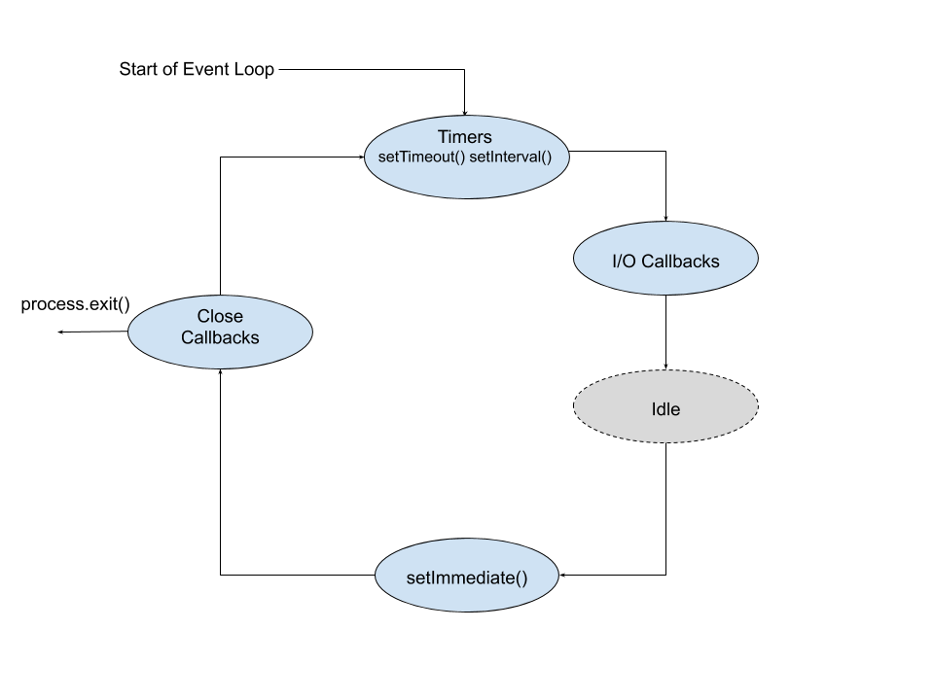
10. Escaping event loop
Sometimes you need to break out of a loop for any reason.
Escaping event loop is a process to stop the wait for a particular objective if it is done.
For example, you may want to stop iterating through an array of items as soon as you find a specific element.

